Slide 1
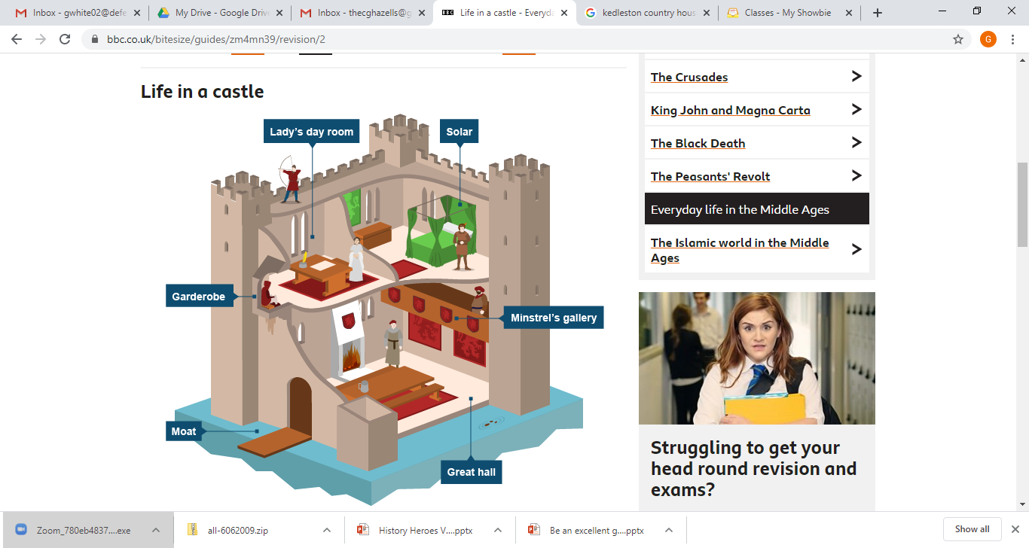
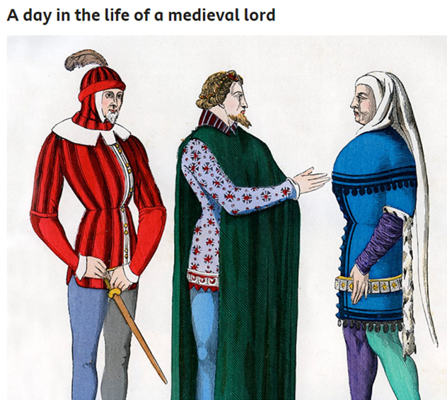
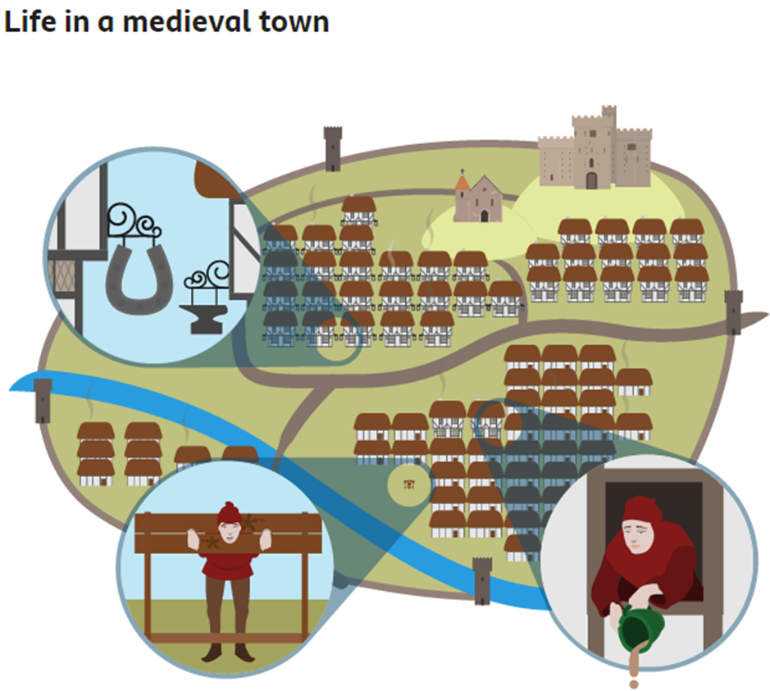
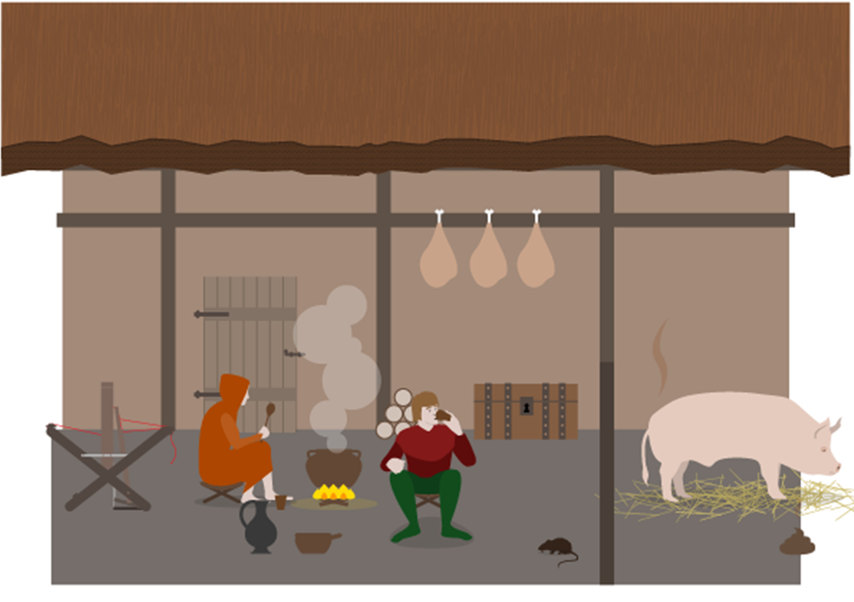
Living conditions in the middle ages
Knowledge organiser
Lesson aims
The middles ages (also the medieval period) is:
1250 - 1500
Lords and nobles were wealthy
Lords went hunting
Lords had meals with lots of courses and expensive meat
Life in a castle was grand and fancy
The castle would be lived in by nobles and their family
They would have a great hall
Medieval towns were filthy
There was no plumbing and no toilets in peoples homes
Towns had animals roaming around
Peasants were at the bottom of the feudal system
Life was hard and back breaking

Slide 2
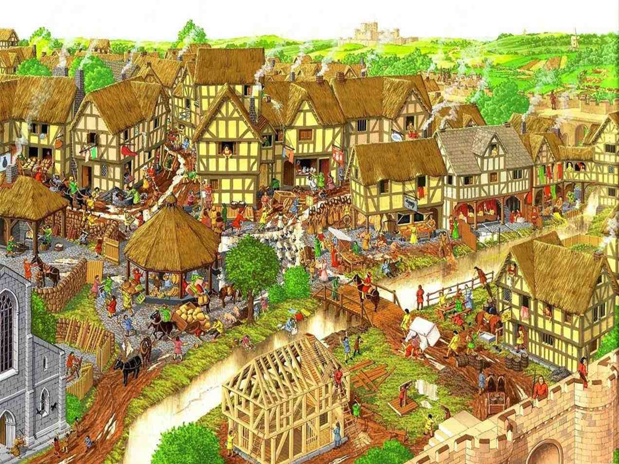
Living conditions in the middle ages
DO NOW:
Look at the picture of a medieval town. Identify 5 things that would cause poor hygiene, disease or dirty living conditions
-
-
-
-
-

Slide 3


Slide 4
DO NOW: Feedback
Human waste (urine and faeces) being thrown out of the windows onto the streets
Some of the things you may have noticed:
The town is cramped, there is no running water and human waste is on the street
Farm animals roam the street, adding their own waste to the mess
People are washing their clothes in the dirty river, having a bath and even collecting their cooking and drinking water!
People urinating/ throwing up into the river

Slide 5
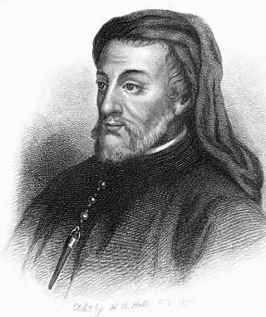
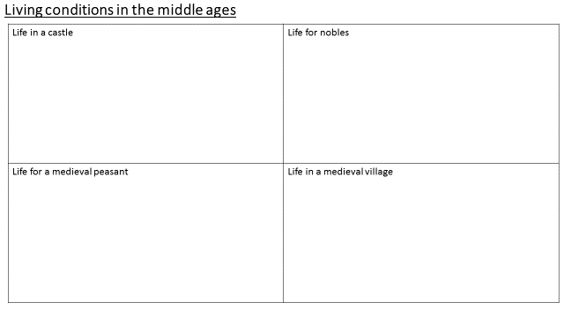
Living conditions in the middle ages
Hello. My name is Geoffrey Chaucer. You may have heard of me, I am kind of a big deal in the literary world?
Anyway, we are going to take a look at life in my world. Life in the middle ages!
Task: We are going to explore 4 different aspects of medieval life:
- Life in a castle
Life in a medieval town
Life for the nobles and the wealthy
Life for peasants and the poor
Using the A5 information pack, add 3 pieces of information to each box. This is an important skill – gathering information from text and summarising it into your own words.

Slide 6
Living conditions in the middle ages
Life in a castle The great hall was the centre of a castle and the walls were decorated with tapestries | Life for nobles
Life for a medieval peasant | Life in a medieval village Let’s read some of the information together and pick one piece of information for this box
I DO:
WE DO:

Slide 7
Living conditions in the middle ages
Using the information you have collected this lesson, answer this question:
‘ How did living conditions encourage the spread of disease?’
THINK:
What helps disease spread?
Was diet good in the middle ages?
What were the streets like?
I DO: Living conditions encouraged the spread of disease in the middle ages.
One of the reasons was diet was poor for peasants, they relied on what grew. If the harvest failed they would sometimes starve to death.
WE DO: This would encourage the spread of disease because…..
YOU DO: Write about the state of the streets and explain how it encouraged the spread if disease

Slide 8
Exit ticket
True or false
Towns were very clean and tidy during the middle ages
The middles ages is they years 1500-1750
Doctors and access to health services were free in the middle ages
Peasants relied on what grew in order to eat
Lords and nobles lived in huts
Towns were very clean and tidy during the middle ages
The middles ages is they years 1500-1750
Doctors and access to health services were free in the middle ages
Peasants relied on what grew in order to eat
Lords and nobles lived in huts

Slide 9
Resources

Slide 10
Living conditions in the middle ages
Life in a castle | Life for nobles
Life for a medieval peasant | Life in a medieval village

